Slide 1
Energy Perception vs. Reality in France and Germany
Célia Djouadi
Oussama El Fatihi

Slide 2
Project presentation
Subject :
Public Perception vs. Reality
Sentiment and Data Analysis
Actionable Insights
Questions we would like to answer :
What are the key differences between public perception and actual data regarding energy production in France and Germany ?
How does sentiment vary across different energy types ?
Are public opinions aligned with emission realities ?

Slide 3
Data sources
Public Opinion:
Reddit API
Sentiment analysis of posts/comments from energy-related subreddits (France & Germany).
France: RTE CSV (energy production & emissions).
Germany: Energy-Chart API (production) & CSV (emissions)

Slide 4
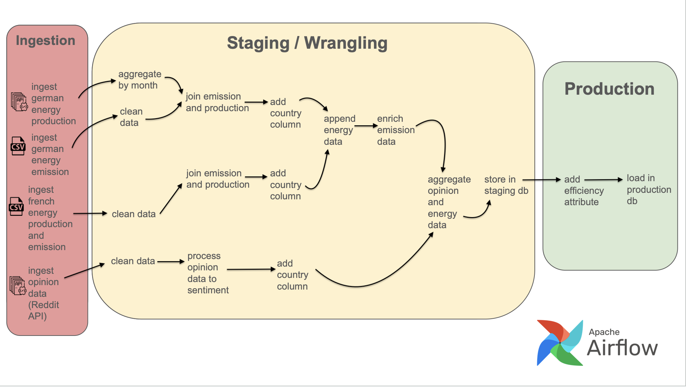
Pipeline design

Slide 5
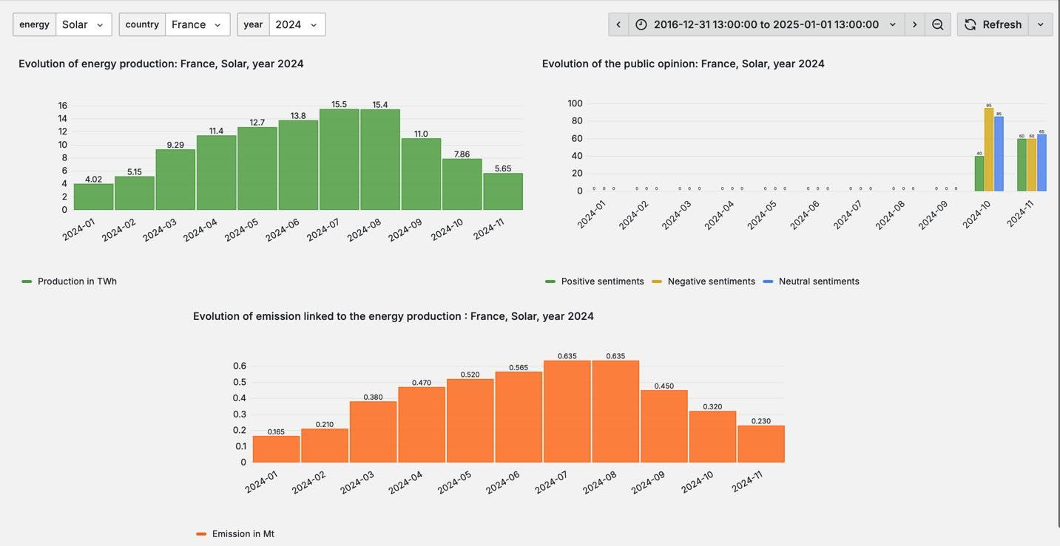
Data visualization in Grafana

Slide 6
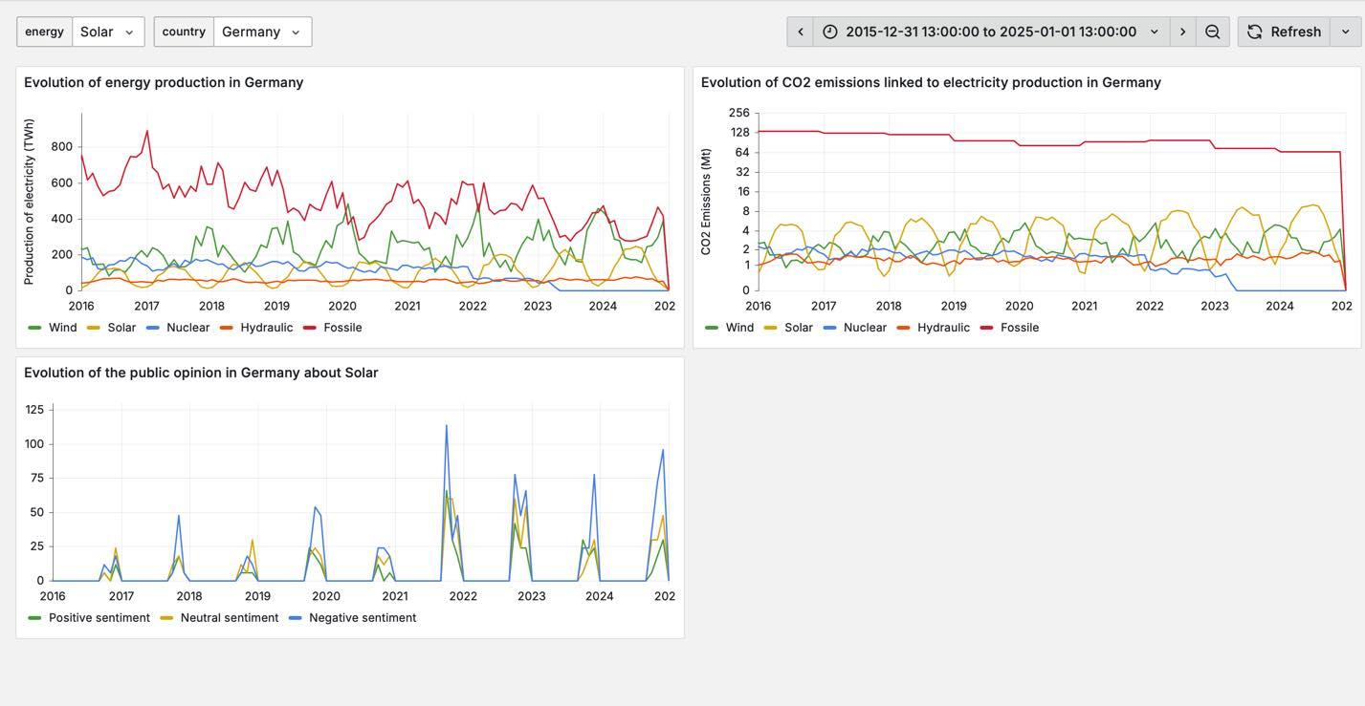
Data visualization in Grafana

Slide 7
Analysis and limitations
Key Observations
Nuclear Energy:
Negative sentiment in Germany aligns with nuclear phase-out policy.
Positive sentiment in France reflects reliance on nuclear energy.
Renewables: Positively perceived in both countries, consistent with global green energy trends.
Data Limitations
Temporal Gap: Limited public opinion data before 2018.
Sampling Bias: Reddit comments, often negative, may skew sentiment analysis.
Impact of limitations
Results may not represent the broader population due to Reddit-specific biases.
Broader datasets (e.g., surveys, other platforms) are needed for more accurate insights.

Slide 8
Next steps
Enhance Sentiment Analysis
Automate Data Ingestion
Expand Visualizations
Address Data Gaps

Slide 9
Example of results with LLM (Gemini)
“Ich finde es interessant, dass die Regierung so viel Geld in erneuerbare Energien investiert. Ich hoffe, dass sich das langfristig auszahlt."
Translation : I find it interesting that the government is investing so much money in renewable energies. I hope it pays off in the long term.
True information

